Slide 1
BNFO262: Quantitative Methods in Genetics and Genomics
Module 1 Day 1 - 01/06/25
Notes:
PJ

Slide 2
Introduction to the Class

Slide 3

Course Instructor
Alon Goren, PhD
agoren@ucsd.edu
Associate Professor, Medicine
goren-lab.github.io

Slide 4




TA Introductions
Yuwei Cao
yuc408@ucsd.edu
4th year PhD Student
Bioinformatics & Systems Biology
Goren Lab
Jenny Dong
wed009@ucsd.edu
4th year PhD Student
Bioinformatics & Systems Biology
Ren Lab
Noa Popko
nopopko@ucsd.edu
2nd year PhD Student
Bioinformatics & Systems Biology
Carter Lab
Chris Brown
crb003@ucsd.edu
2nd year PhD Student
Bioinformatics & Systems Biology
Chavez Lab

Slide 5




What’s bioinformatics? Why learn about it?
“Bioinformatics is the application of tools of computation and analysis to the capture and interpretation of biological data”
Notes:
Bio for biology, informatics for computer science
New integrative, multidisciplinary field to use computational tools to analyze biological data
When you think of scientist, you might imagine a person in a white lab coat examining cells under a microscope, but most bioinformaticians are actually at their laptop
Source: https://www.bmj.com/content/324/7344/1018

Slide 6
…why are you here in BNFO262?
If you’re a wet lab scientist
Might be looking to learn about the basics of programming and how to complete standard bioinformatic analyses
If you’re a bioinformatician / computational biologist
You’re trying to expand your bioinformatics repertoire
Notes:
Diverse backgrounds

Slide 7
…why are you here in BNFO262?
You’re going to generate a lot of data as part of your scientific career
If you outsource your bioinformatics you will have results at some point when the bioinformatician is free and in a good mood and feels like helping you out, if you learn bioinformatics you have full control over how and when your data is processed
Notes:
Overall goals of this class: broad overview of a variety of genetics based bioinformatics applications, getting exposure to basic tools for data analysis from experts, give you the foundational skills to analyze whatever data you may have

Slide 8
Course Logistics

Slide 9

Course Schedule and Overview on GitHub
Github is a hosting service for git repositories.
All of our resources are there!
https://github.com/biom262/bnfo262-2026

Slide 10
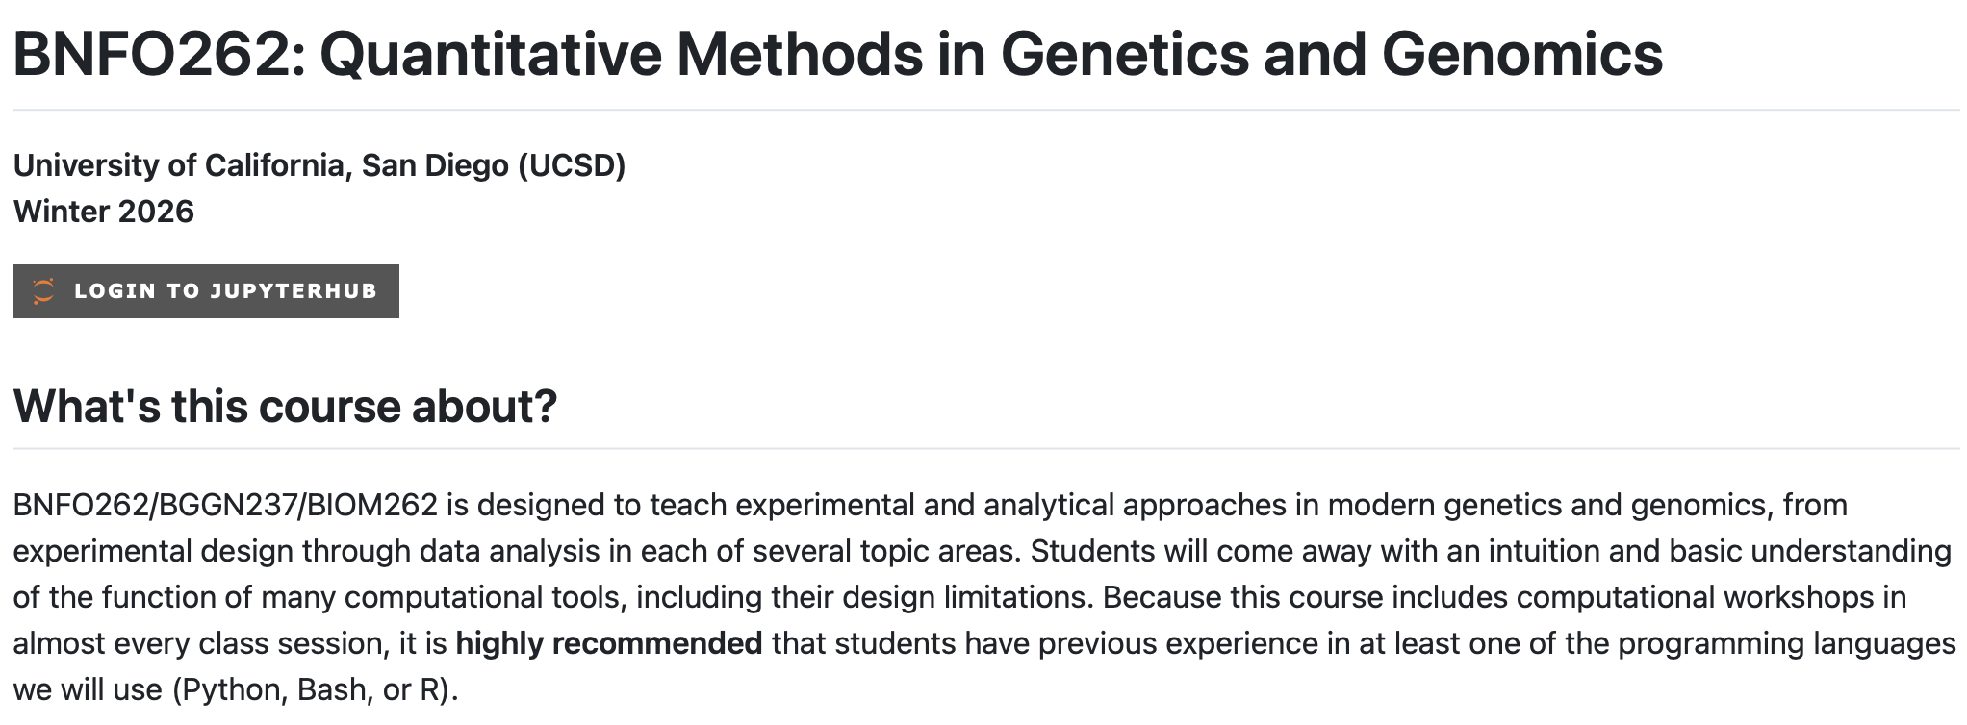
Course Syllabus on GitHub
https://github.com/biom262/bnfo262-2026/blob/main/BNFO262-Syllabus-2026.md

Slide 11
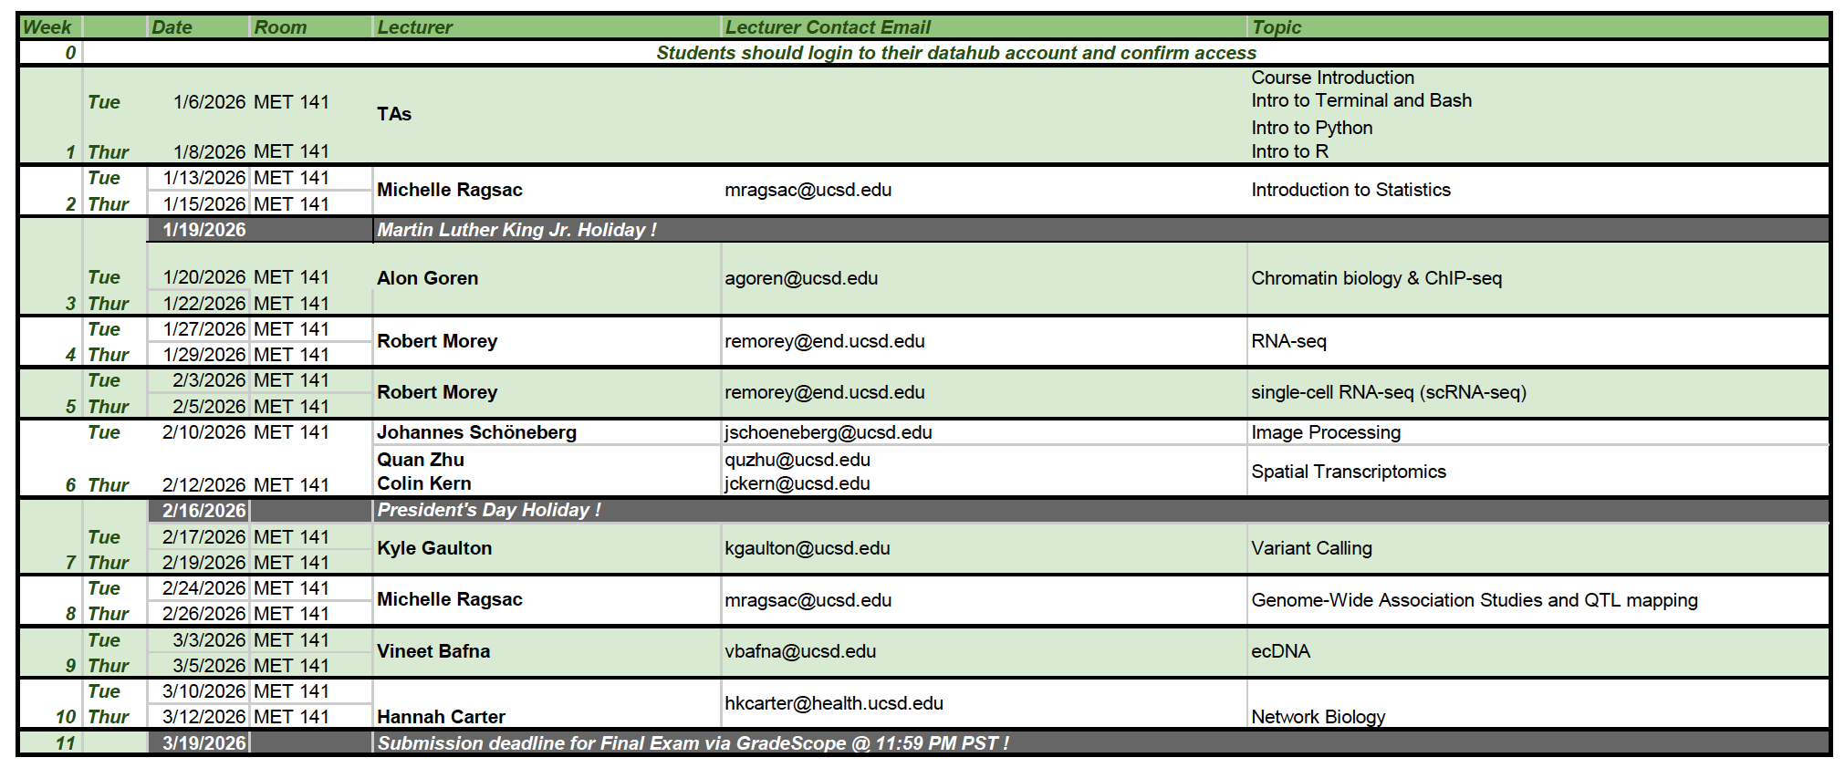
Class Schedule

Slide 12
Course Prerequisites
an introductory knowledge of genetics
some introductory experience with a programming language, preferably R or python
Take a look at our course material from last year to gauge the level of programming experience required. If you think you might need to refresh yourself, here are some resources:
A book introducing R for data scientists
A crash-course book for python
A book that explains how to use data science libraries in python
The head-first python series
Code Academy's Python series

Slide 13
Class Attendance and Participation
Class attendance is not mandatory but highly recommended!
Class Zoom link is for recording purposes and please contact the instruction team if you cannot attend class in person and would like to attend by Zoom
You will be able to log your attendance on Gradescope every class session you attended (due 1PM the day of class)
A survey for each week’s module will be released after Thursday’s class that week and due before Tuesday’s class the following week. Please enter the “secret code” at the end of survey submission into the Module Survey assignment on Gradescope to earn credit.
Participation grades will be given based off class participation and 10 weekly surveys completed.

Slide 14
Grading Breakdown
3 homework assignments: 55%
Midterm: 20%
Final: 20%
Participation: 5%
Attendance : 3% (extra)
All assignments will be submitted using Gradescope.
https://www.gradescope.com/courses/1205361
Entry Code: 5DKJRJ

Slide 15
Assignments Policy
Homeworks/Midterm/Final will be released on Thursdays after class and due on the following Thursday before class. Submission of all assignments will be conducted through Gradescope.
Late Submissions Policy: For each late submission 10% of the maximal number of points is deducted for every day or part of a day that an assignment is handed in late
Regrade Policy: We will allow one homework regrade throughout the quarter for full credit back. The student must score below 80% on the assignment and they must resubmit within one week of when the assignment's grades were published.

Slide 16
Policy on collaboration and plagiarism
Do not copy and paste answers from the internet and make sure all answers on homework and exams are completely in your own words.
You’re welcome to discuss homework assignments with classmates, but all work must be done individually.
Please make sure you cite any collaborations or online sources (website, papers, AI use etc.)

Slide 17

Jupyter Notebook
“The Jupyter Notebook is an open-source web application that allows you to create and share documents that contain live code, equations, visualizations, and narrative text.”
Visualizations
Mathematical equations
Statistical modeling
Narrative text
Any other rich media
Tutorial: Introduction to Jupyter Notebook

Slide 18

Logging into DataHub and Accessing Jupyter Notebooks
Go to https://datahub.ucsd.edu/
Click “Log in”. This should take you to the google sign-in page

Slide 19
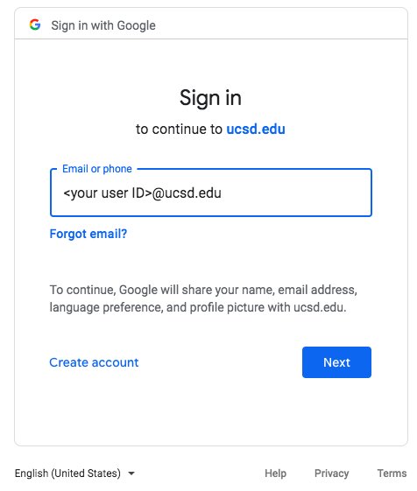
3. Sign in using your @ucsd.edu email. This will take you to the SSO page where you will have to type in your username and password and authenticate using Duo

Slide 20
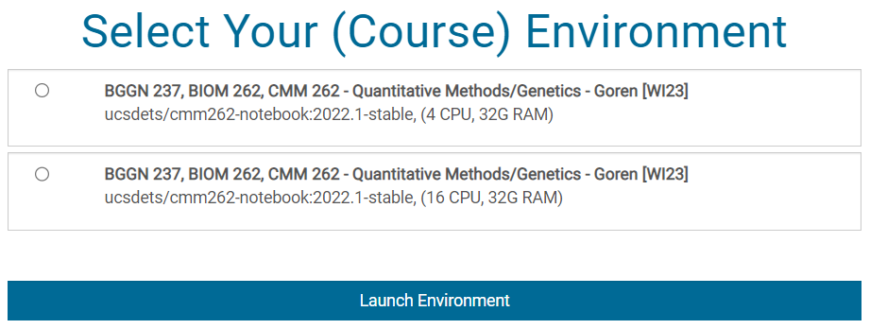

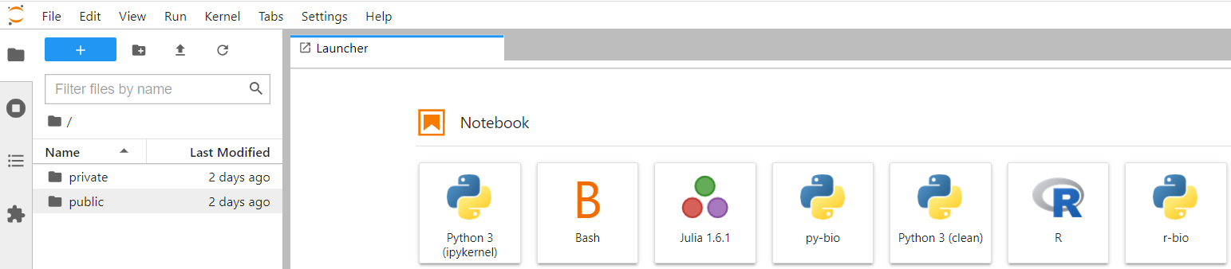
4. Now you should see a page that looks like this.
Select BNFO 262 ghcr.io/biom262/cmm262-notebook:programming-R and click “Launch Environment”
①
②
Your screen should look something like this:

Slide 21
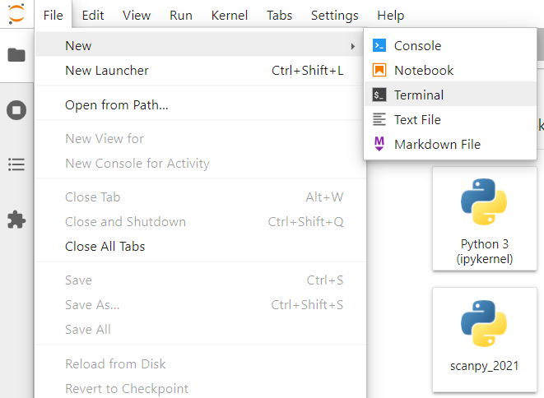
5. Open a new terminal window by going to File > New > Terminal
Open Datahub
Go to "File" > "New" > "Terminal"

Slide 22
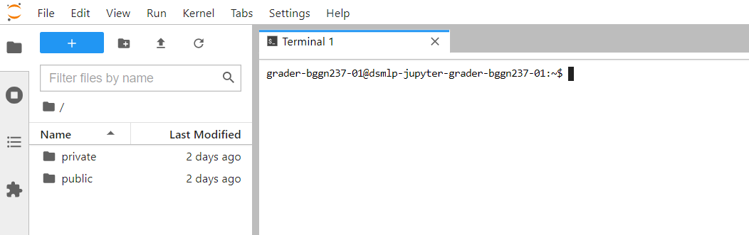
6. Your screen should look like this

Slide 23
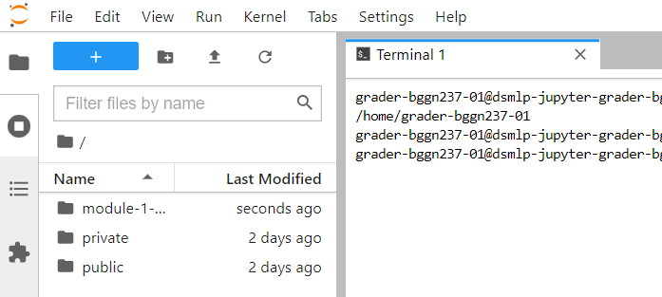
7. In your terminal window, type in pwd. The returned path should be:
/home/<your user ID>
8. Copy over the directory with all of the notebooks for module 1 using the following command:
cp -r ~/public/bnfo262-2026/module-1-programming ~/private/bnfo262-2026
9. You should now see the module-1-programming directory on your jupyterhub homepage. (You might need to click the refresh button.)

Slide 24
Module 1 Programming Day 1: Terminal and Bash Scripting
Yuwei Cao & Noa Popko
Content adapted/modified from: Arya Massarat

Slide 25
Outline
Intro to the file system
Exercise 1 & break! (also time for any questions)
Manipulating files
Exercise 2 & break! (also time for any questions)
Automating your work
Notes:
Just a quick outline of the plan. We'll start …
At that point, we’ll take a break and I’ll give you a chance to ask any questions…

Slide 26
Overview
Intro to the file system
Intro: What is a terminal? What can you do with it?
Anatomy of a command
Navigating the file system
Understanding help and manual pages
Wildcards and globbing
Conveniences: tab completion and bash history
Altering the file system
Exercise 1 & break! (also time for any questions)
Manipulating files
Printing things
Under the hood: standard input, output, and error
Redirections and Pipes
Variables
Quoting
Command substitution: storing output in variables
Working with files
Exercise 2 & break! (also time for any questions)
Automating your work
Got long-running commands? Use job control
Working with larger files
Logic control: for loops and if statements
Bash: also a programming language
Creating bash scripts and making them into commands
Notes:
Just a quick outline of the plan. We'll start …
At that point, we’ll take a break and I’ll give you a chance to ask any questions…

Slide 27
Outline
Intro to the file system
Notes:
Just a quick outline of the plan. We'll start …
At that point, we’ll take a break and I’ll give you a chance to ask any questions…

Slide 28
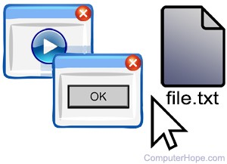
Two ways to give your computer instructions
Before there was a graphical user interface (GUI), how did people communicate with their computers?
GUI
Notes:
Let's start with a big question. How do you tell your computer what to do? Most of us communicate instructions to our computers using a graphical user interface (or GUI). This is just an app that has items you can click, enter text into, and interact with. For example, a browser like Google Chrome or Firefox, or any app like Slack -- or even the Windows or Mac operating systems come with a built-in GUI.

Slide 29
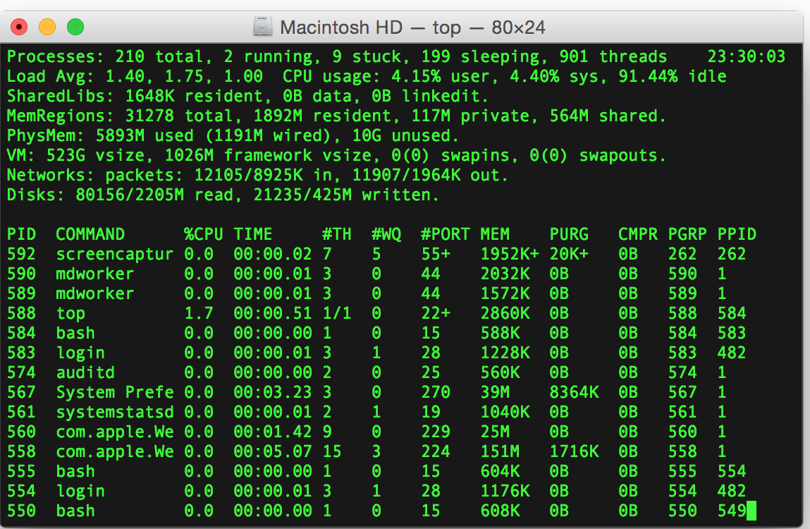
Two ways to give your computer instructions
Before there was a graphical user interface (GUI), how did people communicate with their computers?
You can do everything you usually do by entering typed commands
Using the “terminal”
GUI
vs
Terminal
Notes:
But before there were GUIs, there were terminals! This is a simple box with text.
You can enter a command, press enter, and then the terminal will respond by outputting its own text to the screen. The terminal usually offers you the ability to do much more than is possible in a GUI, which is why we use it so often in bioinformatics.

Slide 30
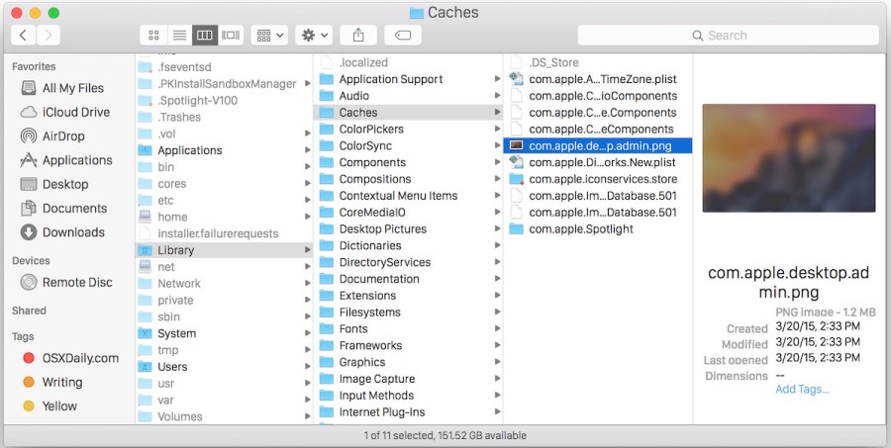
An Example GUI: The Mac Finder
At any given moment, you are located in a specific folder (aka directory)
“current working directory”
There is a root directory that contains all of the folders on your computer:
Applications
Library
System
Users
There is a path from the root to your current folder:
/Library/Caches
Root
Applications
Library
System
Users
Audio
Caches
Fonts
…
Notes:
Now that we’ve discussed the difference between GUIs and the terminal in high level terms, let’s look at an example…
…well, it turns out that we can do all of the things that Finder can do right within the terminal.

Slide 31
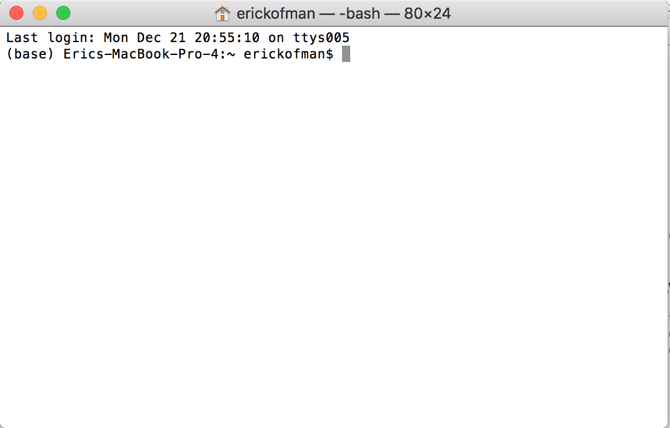
What can you do in the terminal?
Navigating file systems
Creating a file
Moving a file
Copying a file
Deleting a file
Renaming a file
Running a program
And so much more!
Notes:
For each of the tasks that you can imagine doing in Finder, there is a command that does the same thing within the terminal…
…in the first section of this module, I’ll prove to you that we can replicate Finder within our terminals.

Slide 32

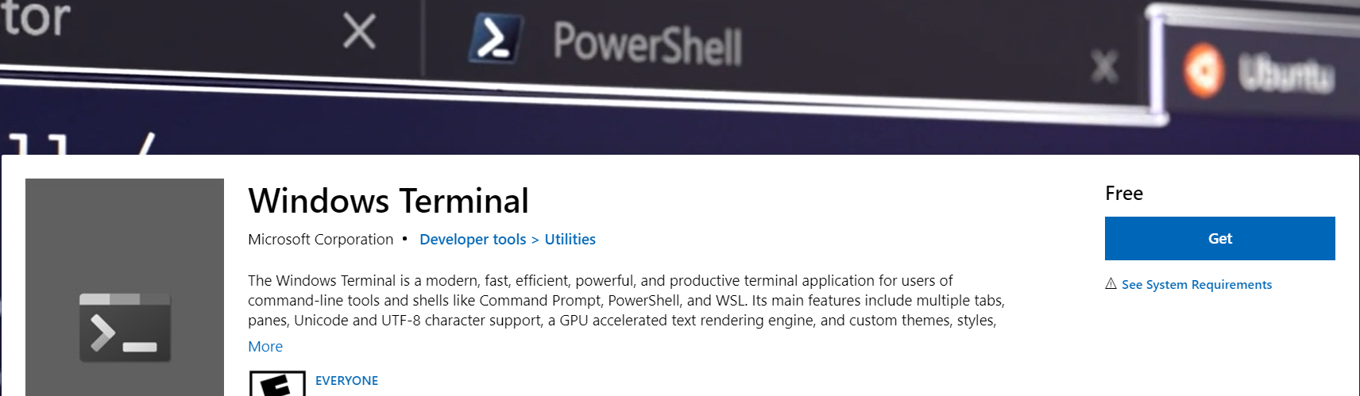
Where is this “Terminal”?
Mac
Windows
Windows users Setup WSL: https://docs.microsoft.com/en-us/windows/wsl/setup/environment
Notes:
But first, a quick note that both Mac and Windows have terminals you can use! If you're on Windows, you'll probably want to setup this thing called WSL.

Slide 33
Demo using Datahub
Open Datahub
Go to "File" > "New" > "Terminal"
Notes:
We won't actually be using your terminal in this class, though. Instead, we'll be using Datahub!
If you haven’t already, please open Datahub and then click "File" > "New" > "Terminal"
There is a notebook for this module available on Github but I won't be stepping through it today. If you get lost or forget something and want to revisit what we did, feel free to refer to it, though. All of the commands we run today will come from the notebook.

Slide 34
Anatomy of a Command
cmd [flags] [arguments]
Notes:
But before we start learning a bunch of commands, I want to give you a quick idea about the structure that these commands usually take…

Slide 35
Anatomy of a Command
cmd [flags] [arguments]
cmd - the command name
flags (aka options) - modifies the behavior of the command; always prefixed by a dash: -
There are two forms:
short (ex: -h)
can be combined (ex: -lh instead of -l -h)
long (ex: --human-readable instead of -h)
always prefixed by two dashes: --
There are two types:
optional arguments (ex: --color=always)
switches (ex: -l -h)
arguments - inputs to the command; either strings or paths

Slide 36
Anatomy of a Command
ls --color=always -l -h hello.sh
cmd [flags] [arguments]
command name
cmd - the command name
flags (aka options) - modifies the behavior of the command; always prefixed by a dash: -
There are two forms:
short (ex: -h)
can be combined (ex: -lh instead of -l -h)
long (ex: --human-readable instead of -h)
always prefixed by two dashes: --
There are two types:
optional arguments (ex: --color=always)
switches (ex: -l -h)
arguments - inputs to the command; either strings or paths
flags (aka options)
arguments

Slide 37
Anatomy of a Command
ls --color=always -l -h hello.sh
cmd [flags] [arguments]
command name
cmd - the command name
flags (aka options) - modifies the behavior of the command; always prefixed by a dash: -
There are two forms:
short (ex: -h)
can be combined (ex: -lh instead of -l -h)
long (ex: --human-readable instead of -h)
always prefixed by two dashes: --
There are two types:
optional arguments (ex: --color=always)
switches (ex: -l -h)
arguments - inputs to the command; either strings or paths
flags (aka options)
arguments
ls - lists files
--color=always - turns on color-highlighting of output
-l - turns on long-mode output to display more info
-h - makes file sizes in output human-readable
ex: instead of 4575, we get 4.5K
hello.sh - path to file named hello.sh

Slide 38
Anatomy of a Command
ls --color=always -l -h hello.sh
cmd [flags] [arguments]
command name
cmd - the command name
flags (aka options) - modifies the behavior of the command; always prefixed by a dash: -
There are two forms:
short (ex: -h)
can be combined (ex: -lh instead of -l -h)
long (ex: --human-readable instead of -h)
always prefixed by two dashes: --
There are two types:
optional arguments (ex: --color=always)
switches (ex: -l -h)
arguments - inputs to the command; either strings or paths
flags (aka options)
arguments
ls - lists files
--color=always - turns on color-highlighting of output
-l - turns on long-mode output to display more info
-h - makes file sizes in output human-readable
ex: instead of 4575, we get 4.5K
hello.sh - path to file named hello.sh

Slide 39
Anatomy of a Command *
ls --color=always -l -h hello.sh
cmd [flags] [arguments]
command name
cmd - the command name
flags (aka options) - modifies the behavior of the command; always prefixed by a dash: -
There are two forms: *
short (ex: -h)
can be combined (ex: -lh instead of -l -h) *
long (ex: --human-readable instead of -h)
always prefixed by two dashes: -- *
There are two types:
optional arguments (ex: --color=always)
switches (ex: -l -h)
arguments - inputs to the command; either strings or paths
flags (aka options)
arguments
ls - lists files
--color=always - turns on color-highlighting of output
-l - turns on long-mode output to display more info
-h - makes file sizes in output human-readable
ex: instead of 4575, we get 4.5K
hello.sh - path to file named hello.sh
*Describes commands that follow the POSIX standard. Not all commands are standards-compliant.
Notes:
10 min check-in
…now, let's switch over to the terminal!

Slide 40
Navigating the File System
pwd: print the path to the working directory
The first “ / ” corresponds to the root directory
The tilde sign ( ~ ) represents to the user’s home directory
whoami: what is my username?
Notes:
remember to mention that / corresponds to the root directory!
the terminal always starts up in the home directory
this is also sometimes referred to by a single backtick or tilde

Slide 41
Navigating the File System
pwd: print the path to the working directory
whoami: what is my username?
tree: display the directory tree
cd: change my working directory
ls: list contents of a directory
cmd [path_to_dir]

Slide 42
Navigating the File System
$ tree ~/private/bnfo262-2025/module-1-programming
~/public/bnfo262-2025/module-1-programming
├── bash_playground
│ ├── scripts
│ │ ├── hello.sh
│ │ ├── hello_to_all_of_you.sh
│ │ └── hello_you.sh
│ └── sequences.txt
├── data
│ ├── chrom_lengths.tsv
│ ├── gene_chrom.tsv
│ ├── GSE166925-meta.tsv
│ ├── hg19.chrom.sizes.txt
│ └── PMC8440637_top_genes.txt
├── README.md
├── Terminal_Commands_and_Bash_Scripting.ipynb
└── img
pwd: print the path to the working directory
whoami: what is my username?
tree: display the directory tree
cd: change my working directory
ls: list contents of a directory
cmd [path_to_dir]
Reminder: the tilde ~ refers to the home directory, where the terminal starts up

Slide 43
Navigating the File System
$ tree ~/private/bnfo262-2025/module-1-programming
~/public/bnfo262-2025/module-1-programming
├── bash_playground
│ ├── scripts
│ │ ├── hello.sh
│ │ ├── hello_to_all_of_you.sh
│ │ └── hello_you.sh
│ └── sequences.txt
├── data
│ ├── chrom_lengths.tsv
│ ├── gene_chrom.tsv
│ ├── GSE166925-meta.tsv
│ ├── hg19.chrom.sizes.txt
│ └── PMC8440637_top_genes.txt
├── README.md
├── Terminal_Commands_and_Bash_Scripting.ipynb
└── img
pwd: print the path to the working directory
whoami: what is my username?
tree: display the directory tree
cd: change my working directory
ls: list contents of a directory
cmd [path_to_dir]
Reminder: the tilde ~ refers to the home directory, where the terminal starts up

Slide 44
Paths: relative vs absolute paths
$ tree ~/private/bnfo262-2025/module-1-programming
~/public/bnfo262-2025/module-1-programming
├── bash_playground
│ ├── scripts
│ │ ├── hello.sh
│ │ ├── hello_to_all_of_you.sh
│ │ └── hello_you.sh
│ └── sequences.txt
├── data
│ ├── chrom_lengths.tsv
│ ├── gene_chrom.tsv
│ ├── GSE166925-meta.tsv
│ ├── hg19.chrom.sizes.txt
│ └── PMC8440637_top_genes.txt
├── README.md
├── Terminal_Commands_and_Bash_Scripting.ipynb
└── img
There are two types of paths:
Relative - interpreted relative to your current working directory
Absolute - independent of current working directory (i.e. relative to the root directory)
Example: equivalent relative and absolute path
scripts/hello.sh
~/module-1-programming/bash_playground/scripts/hello.sh
Reminder: the tilde ~ refers to the home directory, where the terminal starts up

Slide 45
Paths: different ways of writing a path
$ tree ~/private/bnfo262-2025/module-1-programming
~/public/bnfo262-2025/module-1-programming
├── bash_playground
│ ├── scripts
│ │ ├── hello.sh
│ │ ├── hello_to_all_of_you.sh
│ │ └── hello_you.sh
│ └── sequences.txt
├── data
│ ├── chrom_lengths.tsv
│ ├── gene_chrom.tsv
│ ├── GSE166925-meta.tsv
│ ├── hg19.chrom.sizes.txt
│ └── PMC8440637_top_genes.txt
├── README.md
├── Terminal_Commands_and_Bash_Scripting.ipynb
└── img
Equivalent paths!
scripts/hello.sh
../bash_playground/scripts/hello.sh
scripts/../scripts/hello.sh
scripts/./hello.sh
./scripts/hello.sh
The double-dot “..” refers to the folder above and the single-dot “.” refers to the current folder.
Reminder: the tilde ~ refers to the home directory, where the terminal starts up

Slide 46
Wildcards and globbing
Question marks ? and asterisks * are considered wildcards.
Bash will try to find all the files that match the wildcard. This is called globbing.
A question mark ? matches only one character.
ls ?equences.txt
An asterisk * matches zero or more characters.
ls *es.txt
Expressions with * get expanded to a space-separated list prior to execution
ls scripts/*.sh
Notes:
Globbing is the operation that expands a wildcard pattern into the list of pathnames matching the pattern.
Matching is defined by:
A '?' (not between brackets) matches any single character.
A '*' (not between brackets) matches any string, including the empty string.

Slide 47
Tab completion: it’s better to be lazy
Press <tab> to have the terminal guess (ie auto-complete) your command!
example:
Press <tab> twice when there are multiple options.
example:
ls sc<tab>
Using tab completion helps reduce the chance of typos. Get in the habit of using them all the time!
ls scripts/hello<tab><tab>

Slide 48
Making use of your bash history
Use the up and down arrow keys to cycle through your past commands.
To view all of your past commands, use the history command.
To search for a past command:
Press ctrl+r
Start typing part of the command; the top hit will appear as you type
To move onto the next best hit, press ctrl+r again
Once you’ve found the command, use esc or the arrow keys (or enter if you want to execute it immediately)
Notes:
The terminal has a way of remembering all of the commands that you’ve been typing! You can cycle through…

Slide 49
Altering the File System
mkdir: make a new directory
cp: copy a file or directory
touch: create a new, empty file
mv: move a file or directory
rm: remove a file or directory
rmdir: remove an empty directory
$ tree ~/module-1-programming
~/module-1-programming
├── Day1_1_Intro_to_Programming.ipynb
├── Day1_2_Python_Packages.ipynb
├── Day1_3_Intro_to_Pandas.ipynb
├── Day2_1_R_Basics.ipynb
├── Day2_2_Terminal_Commands_and_Bash_Scripting.ipynb
├── README.md
├── bash_playground
│ ├── scripts
│ │ ├── hello.sh
│ │ ├── hello_to_all_of_you.sh
│ │ └── hello_you.sh
│ └── sequences.txt
├── data
│ ├── chrom_lengths.tsv
│ ├── gene_chrom.tsv
│ └── hg19.chrom.sizes.txt
└── img
mkdir path_to_dir…
cp path_to_source… path_to_dest
touch path_to_file…
mv path_to_source… path_to_dest
rm path_to_file_or_dir…
rmdir path_to_empty_dir…
Usage

Slide 50

Altering the File System: Symlinks
$ tree ~/module-1-programming
~/module-1-programming
├── Day1_1_Intro_to_Programming.ipynb
├── Day1_2_Python_Packages.ipynb
├── Day1_3_Intro_to_Pandas.ipynb
├── Day2_1_R_Basics.ipynb
├── Day2_2_Terminal_Commands_and_Bash_Scripting.ipynb
├── README.md
├── bash_playground
│ ├── data-sym -> ../data
│ ├── scripts
│ │ ├── hello.sh
│ │ ├── hello_to_all_of_you.sh
│ │ └── hello_you.sh
│ └── sequences.txt
├── data
│ ├── chrom_lengths.tsv
│ ├── gene_chrom.tsv
│ └── hg19.chrom.sizes.txt
└── img
symlink: a shortcut to a file or directory
ln -s target new_link
Ex
ln -s ../data data-sym

Slide 51
Understanding help and manual pages
Most commands have usage documentation available via
--help (long format) and/or -h (short format):
cmd --help
and/or
cmd -h
Alternatively, some commands will also register their help via the built-in manual pages in the man command:
(press q to quit or exit-out after opening the manual)
man cmd

Slide 52
An example manual page: man ls
LS(1) User Commands LS(1)
NAME top
ls - list directory contents
SYNOPSIS top
ls [OPTION]... [FILE]...
DESCRIPTION top
List information about the FILEs (the current directory by
default). Sort entries alphabetically if --sort is not specified.
Mandatory arguments to long options are mandatory for short
options too.
-a, --all
do not ignore entries starting with .
--color[=WHEN]
colorize the output; WHEN can be 'always' (default if
omitted), 'auto', or 'never'; more info below
-h, --human-readable
with -l and -s, print sizes like 1K 234M 2G etc.
-l use a long listing format
--help display this help and exit
--version
output version information and exit

Slide 53
An example manual page: man ls
LS(1) User Commands LS(1)
NAME top
ls - list directory contents
SYNOPSIS top
ls [OPTION]... [FILE]...
DESCRIPTION top
List information about the FILEs (the current directory by
default). Sort entries alphabetically if --sort is not specified.
Mandatory arguments to long options are mandatory for short
options too.
-a, --all
do not ignore entries starting with .
--color[=WHEN]
colorize the output; WHEN can be 'always' (default if
omitted), 'auto', or 'never'; more info below
-h, --human-readable
with -l and -s, print sizes like 1K 234M 2G etc.
-l use a long listing format
--help display this help and exit
--version
output version information and exit
ls [OPTION]... [FILE]...
[OPTION]...
[FILE]...
“zero or more options”
“zero or more paths to files”
Notes:
the first part of the synopsis tells us that we can have zero or more options and the second part tells us…

Slide 54
An example manual page: man ls
LS(1) User Commands LS(1)
NAME top
ls - list directory contents
SYNOPSIS top
ls [OPTION]... [FILE]...
DESCRIPTION top
List information about the FILEs (the current directory by
default). Sort entries alphabetically if --sort is not specified.
Mandatory arguments to long options are mandatory for short
options too.
-a, --all
do not ignore entries starting with .
--color[=WHEN]
colorize the output; WHEN can be 'always' (default if
omitted), 'auto', or 'never'; more info below
-h, --human-readable
with -l and -s, print sizes like 1K 234M 2G etc.
-l use a long listing format
--help display this help and exit
--version
output version information and exit
ls [OPTION]... [FILE]...
[OPTION]...
[FILE]...
[ ]
…
“zero or more options”
“zero or more paths to files”
In general…
“this is optional”
“you can use this multiple times”

Slide 55
An example manual page: man ls
LS(1) User Commands LS(1)
NAME top
ls - list directory contents
SYNOPSIS top
ls [OPTION]... [FILE]...
DESCRIPTION top
List information about the FILEs (the current directory by
default). Sort entries alphabetically if --sort is not specified.
Mandatory arguments to long options are mandatory for short
options too.
-a, --all
do not ignore entries starting with .
--color[=WHEN]
colorize the output; WHEN can be 'always' (default if
omitted), 'auto', or 'never'; more info below
-h, --human-readable
with -l and -s, print sizes like 1K 234M 2G etc.
-l use a long listing format
--help display this help and exit
--version
output version information and exit
ls [OPTION]... [FILE]...
[OPTION]...
[FILE]...
[ ]
…
“zero or more options”
“zero or more paths to files”
In general…
“this is optional”
“you can use this multiple times”
most commands have a --version or -v option

Slide 56
Another example manual page: man ln
LN(1) User Commands LN(1)
NAME top
ln - make links between files
SYNOPSIS top
ln [OPTION]... [-T] TARGET LINK_NAME
ln [OPTION]... TARGET
ln [OPTION]... TARGET... DIRECTORY
ln [OPTION]... -t DIRECTORY TARGET...
DESCRIPTION top
In the 1st form, create a link to TARGET with the name LINK_NAME.
In the 2nd form, create a link to TARGET in the current
directory. In the 3rd and 4th forms, create links to each TARGET
in DIRECTORY. Create hard links by default, symbolic links with
--symbolic. By default, each destination (name of new link)
should not already exist. When creating hard links, each TARGET
must exist. Symbolic links can hold arbitrary text; if later
resolved, a relative link is interpreted in relation to its
parent directory.
Mandatory arguments to long options are mandatory for short
options too.
-s, --symbolic
make symbolic links instead of hard links
--help display this help and exit
--version
output version information and exit
Each of these is a different way that you can use ln

Slide 57
Another example manual page: man ln
LN(1) User Commands LN(1)
NAME top
ln - make links between files
SYNOPSIS top
ln [OPTION]... [-T] TARGET LINK_NAME
ln [OPTION]... TARGET
ln [OPTION]... TARGET... DIRECTORY
ln [OPTION]... -t DIRECTORY TARGET...
DESCRIPTION top
In the 1st form, create a link to TARGET with the name LINK_NAME.
In the 2nd form, create a link to TARGET in the current
directory. In the 3rd and 4th forms, create links to each TARGET
in DIRECTORY. Create hard links by default, symbolic links with
--symbolic. By default, each destination (name of new link)
should not already exist. When creating hard links, each TARGET
must exist. Symbolic links can hold arbitrary text; if later
resolved, a relative link is interpreted in relation to its
parent directory.
Mandatory arguments to long options are mandatory for short
options too.
-s, --symbolic
make symbolic links instead of hard links
--help display this help and exit
--version
output version information and exit
Each of these is a different way that you can use ln
1) ln [OPTION]... [-T] TARGET LINK_NAME
[OPTION]...
TARGET
LINK_NAME
“zero or more options”
“the path to an existing file”
“the file name of the new link”

Slide 58
Another example manual page: man ln
LN(1) User Commands LN(1)
NAME top
ln - make links between files
SYNOPSIS top
ln [OPTION]... [-T] TARGET LINK_NAME
ln [OPTION]... TARGET
ln [OPTION]... TARGET... DIRECTORY
ln [OPTION]... -t DIRECTORY TARGET...
DESCRIPTION top
In the 1st form, create a link to TARGET with the name LINK_NAME.
In the 2nd form, create a link to TARGET in the current
directory. In the 3rd and 4th forms, create links to each TARGET
in DIRECTORY. Create hard links by default, symbolic links with
--symbolic. By default, each destination (name of new link)
should not already exist. When creating hard links, each TARGET
must exist. Symbolic links can hold arbitrary text; if later
resolved, a relative link is interpreted in relation to its
parent directory.
Mandatory arguments to long options are mandatory for short
options too.
-s, --symbolic
make symbolic links instead of hard links
--help display this help and exit
--version
output version information and exit
Each of these is a different way that you can use ln
1) ln [OPTION]... [-T] TARGET LINK_NAME
[OPTION]...
TARGET
LINK_NAME
“zero or more options”
“the path to an existing file”
“the file name of the new link”
in general, you will almost never omit --symbolic

Slide 59
Exercise 1
break for questions/water/stretching
Try this on your own:
Create an empty directory called grad_school
Create an empty file in that directory and name it with your name
Create a symlink to that file from the current directory called linked_me
Delete the directory you created
Delete the symlink

Slide 60
Exercise 1
Try this on your own:
Create an empty directory called grad_school
Create an empty file in that directory and name it with your name
Create a symlink to that file from the current directory called linked_me
Delete the directory you created
Delete the symlink
mkdir grad_school touch grad_school/yourname ln -s grad_school/yourname linked_me rm -r grad_school rm linked_me

Slide 61
Outline
Intro to the file system
Exercise 1 & break! (also time for any questions)
Manipulating files
Notes:
Just a quick outline of the plan. We'll start …
At that point, we’ll take a break and I’ll give you a chance to ask any questions…

Slide 62
Printing things
Usage
cat: print the contents of files
wc: count the number of lines or words in a file
head: print the top of a file
tail: print the end of a file
echo: print a string
cat path_to_file…
wc [path_to_file]...
head [path_to_file]…
tail [path_to_file]…
echo [string]…

Slide 63
Under the hood: standard input, output, and error
cmd
stdout
stdin
stderr
Notes:
Every program has a standard input, a standard output, and a standard error
When you execute a program, it will write
any output that it has to its standard output and
any error messages to its standard error

Slide 64
Under the hood: standard input, output, and error
cmd
stdout
terminal
stdin
stderr
terminal
by default, stdout and stderr are written to the terminal
Notes:
Now, normally most commands will not read from standard input unless explicitly requested
And both standard output and standard error are connected to your terminal, which is why you’re able to see them
But it is also possible to redirect any of these two and from a file

Slide 65
Redirecting stdout and stderr
ls
stdout
file_out
stderr
file_err
ls 1>file_out 2>file_err “Redirect the stdout of ls to file_out and its stderr to file_err”
ls >file_out 2>file_err This is an equivalent shorthand for the above
ls &>file_both “Redirect both stdout and stderr to file_both”
ls >file_out “Redirect the stdout of ls to file_out and its stderr to the terminal”

Slide 66
Redirecting stdout and stderr: appending vs overwriting
ls
stdout
file_out
stderr
file_err
ls 1>>file_out 2>>file_err “Redirect the stdout of ls to file_out and its stderr to file_err”
ls >>file_out 2>>file_err This is an equivalent shorthand for the above
ls &>>file_both “Redirect both stdout and stderr to file_both”
ls >>file_out “Redirect the stdout of ls to file_out and its stderr to the terminal”

Slide 67




Piping from stdout to stdin
history
stdout
stdin
tail
stdout
terminal
stderr
terminal
stderr
terminal
history | tail
“connect the stdout of history to the stdin of tail”
history | tail | head -n5
“connect the stdout of history to the stdin of tail”
“and connect the stdout of tail to the stdin of head
Commands in a pipeline run simultaneously but rarely at the same speed.

Slide 68
Variables
To store the string “hello” inside a variable named my_variable:
Or, alternatively, let’s create two variables and join (aka concatenate) them:
my_variable=hello
echo $my_variable world
hello_var=hello
world_var=world
my_variable=$hello_var$world_var

Slide 69
Use quotes when there are spaces involved
What about this?
my_variable=hello world

Slide 70
Use quotes when there are spaces involved
What about this?
my_variable=hello world
It doesn’t work! But why not?
Spaces are important. They delineate strings.
We need a way to denote that this is all part of a single string.
my_variable=hello world
vs
my_variable=“hello world”

Slide 71
Use quotes when there are spaces involved
my_variable=hello world
vs
my_variable=“hello world”
Returning to our original example…
hello_var=hello
world_var=world
my_variable=$hello_var$world_var
hello_var=hello
world_var=world
my_variable=“$hello_var $world_var”
vs
Quoting rule of thumb
Got a dollar-sign $ in your command somewhere? Wrap it in double quotes! It usually doesn’t hurt.

Slide 72
Use braces to avoid ambiguity
Can we get an underscore _ between the two?
my_variable=$hello_var_$world_var

Slide 73
Use braces to avoid ambiguity
Can we get an underscore _ between the two?
my_variable=$hello_var_$world_var
It doesn’t work! But why not?
We’re telling bash to look for a variable called hello_var_
We need a way to denote where the variable is.
hello_var=hello
world_var=world
my_variable=$hello_var_$world_var
hello_var=hello
world_var=world
my_variable=${hello_var}_$world_var
vs

Slide 74
Double vs single quotes
Single quotes force things to be interpreted literally.
hello_var=hello
world_var=world
my_variable=“$hello_var $world_var”
echo $my_variable
hello_var=hello
world_var=world
my_variable=‘$hello_var $world_var’
echo $my_variable
vs
Within double quotes, expressions with $ are resolved prior to execution.

Slide 75
Storing the stdout of a command in a variable
my_variable=“$(cmd)”
my_variable=$(head -n1 sequences.txt)
echo $my_variable

Slide 76
Working with files
Usage
cut: extract specific columns from a file
tr: substitution of characters in a file
rev: reverse text in a file
paste: merge files horizontally
sort: sort the lines in a file
uniq: filter out duplicate lines in a file
grep: search for lines containing a keyword
sed: scan through a file and make edits
awk: scan through a file and extract text
vim: terminal-based text editor (openvim.com)
cut [path_to_file]...
tr character_set1 character_set2
rev [path_to_file]...
paste [path_to_file]...
sort [path_to_file]...
uniq [path_to_file_input [path_to_file_output]]
grep pattern [path_to_file]...
sed script_pattern [path_to_file]...
awk program-text [path_to_file]...
vim [path_to_file]...

Slide 77
The less command
View large files and text one page at a time.
Example usage
Search down through a file within less:
Press the forward-slash /
Type your search keyword
Press enter
To search up from your current position, use a question-mark ? instead of a forward-slash /
less sequences.txt
history | less
Quit out by pressing q
Scroll with the arrow keys.
Notes:
You can use less to view large files one page at a time. This proves to be incredibly useful in bioinformatics, where most files are very, very large.
also mention how it will only load files into memory once requested
…you can also search for text within less

Slide 78
Exercise 2
break for questions/water/stretching
Try this on your own:
Retrieve just the second column of the third line (seq C) from the sequences.txt file using a combination of tail, head, and cut. Use pipes!

Slide 79
Exercise 2
break for questions/water/stretching
Try this on your own:
Retrieve just the second column of the third line (seq C) from the sequences.txt file using a combination of tail, head, and cut. Use pipes!
head -n 3 sequences.txt | tail -n 1 | cut -f 2

Slide 80
Outline
Intro to the file system
Exercise 1 & break! (also time for any questions)
Manipulating files
Exercise 2 & break! (also time for any questions)
Automating your work
Notes:
Just a quick outline of the plan. We'll start …
At that point, we’ll take a break and I’ll give you a chance to ask any questions…

Slide 81
Got long-running commands? Use job control.
Scenario: You’re about to execute a command that will take several minutes.
Solution: Send it to the background. Keep working while it runs.
Example usage
sleep 7 &
sleep n
This command will take n seconds to finish running
cmd &
Notes:
there are also ways to kill a backgrounded job or bring it back to the foreground, but we don't have time to go over that

Slide 82
Backgrounding a job while it is running
Scenario: You execute a command but then realize (a little too late!) that it will take a long time to finish.
Solution:
Press ctrl+z to temporarily pause the command
Send it to the background using the bg command
To bring it back to the foreground, use the fg command.
Example usage
sleep 120
ctrl+z
bg

Slide 83
Ending a command prematurely
If your command isn’t backgrounded, you can usually kill it by pressing ctrl+c. Otherwise, you’ll have to use the kill command.
Two strategies
kill <PID>
kill <job ID>
Every running command has a process identifier (PID). To list all processes and their PIDs, use the ps command:
Every backgrounded command has a job identifier. To list all jobs and their IDs, use the jobs command:
ps -u $(whoami)
jobs

Slide 84
Working with larger files
Usage
gzip: compress a file
wget: download from a URL
du: print a file’s disk usage
zcat: cat but for gzipped files
commonly used for decompression
zless: less but for gzipped files
useful for viewing a gzipped file without unzipping it first
gzip [path_to_file]...
wget url…
du path_to_file…
zcat [path_to_file]...
zless [path_to_file]...

Slide 85
Logic control: for loops and if statements
for loop
for item in <space_separated_list>; do
cmd “$item”
done
if statement
if [ <logical_statement> ]; then
cmd
fi

Slide 86
Bash as a programming language
What is bash anyways?
A shell programming language used within terminals
An application that reads and interprets all of the commands (i.e. code) that you type into the terminal
The bash program is running right now, awaiting your next command! You can see it when you run
ps -u $(whoami)
You can replace bash with a different shell programming language, if you want.
The default shell is usually bash but on macs it’s zsh.
Takeway
You can write scripts composed from all of the commands we learned!

Slide 87
Creating your own bash script
my_hello.sh
#!/usr/bin/env bash
# this is a comment; it will be ignored
# type a command below
echo “Hello world!”
the shebang
To execute my_hello.sh just run
scripts/hello.sh
Notes:
The first line of every script is called a shebang. It denotes which application to use when executing the script. In this case, the script is written in bash so we use the bash command but it could be anything, even python.

Slide 88
Passing arguments to a script
hello_you.sh
#!/usr/bin/env bash
echo “Hello $1”!
$1 refers to the first argument of the script

Slide 89
Making a script globally available using $PATH
I don’t want to have to type out the full path to hello_you.sh every time.
How can I make it so that I can execute hello_you.sh from anywhere by just typing hello_you.sh?
The changes we made to $PATH aren’t permanent. We would have to add this command to bash’s startup file ~/.bashrc to do that.
PATH=“$PATH:$(pwd)/scripts”
echo “$PATH”
Notice how /usr/bin is listed in $PATH?
Try this:
ls /usr/bin | less
Do you recognize any of those?!
$PATH is a special environment variable that is created by bash on startup. It contains a colon-separated list of directories.
Whenever you type a command, bash will look through these directories to find an executable file that matches it.

Slide 90
We just scratched the surface! How can I learn more?
It’s dry reading, but the GNU bash manual is really quite good (https://www.gnu.org/software/bash/manual/bash.html)
The missing semester of your CS education: an open MIT course (https://missing.csail.mit.edu)
https://explainshell.com and help/manual pages
Other useful topics for bioinformaticians not covered today
writing bash scripts, advanced less usage, kill and fg, git, ssh, sshfs, conda and conda environments, Snakemake, the screen command, process substitution, exit codes, functions, aliases, bash startup, using a computing cluster, regexes, manipulating strings, shell expansions, the diff and comm commands, file and directory permissions, the find and xargs commands, arrays, shell arithmetic, while loops, signals, the top command, the datamash tool, the /dev special files

Slide 91

See you again on Thursday!
Please don’t forget log your attendance on Gradescope (due today at 1pm).
Survey for this module will be released on Thurs after class and is due next Tues at 9 am!

